Slide 1
Act Now to Boost Our Life-Changing Work Online!
Babette Maiss, Public Awareness Chair
publicawareness@soroptimistsnr.org

Slide 2
Tips to Boost Awareness with Digital Marketing

Slide 3
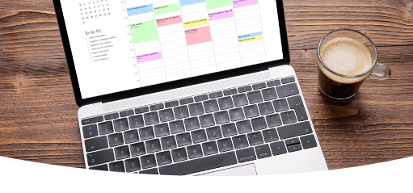
Tip 1: Use online tool to schedule social media posts
●Hootsuite
●Coscheduler
●Publr
●Buffer
●Meta Business Suite

Slide 4
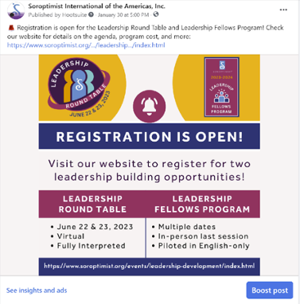
TIP 2: To boost or not boost your social media posts
●Does post have a purpose?
●Does post have a clear call to action?
●Does post link to a landing page?
●Will post generate sales, attendance or leads?

Slide 5
TIP 3: Maximize hashtags
●Google what hashtags are trending
●Use mixture of broad and specific hashtags. For example: #IWD, #InternationalWomensDay, #SoroptimistIWDTeaParty
●Instagram posts may contain 30 hashtags in one post, while Facebook and LinkedIn may only use 3-5 hashtags

Slide 6
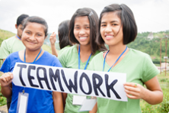
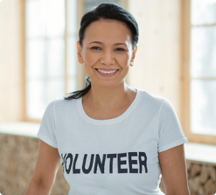
TIP 4: Use high-quality photos
Always get permission to use someone’s photo or video!

Slide 7
TIP 5: Post more videos
● Post videos on social media
● Reels are popular!
● Keep videos 20-45 seconds
● Create vertical videos

Slide 8
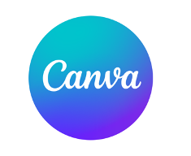
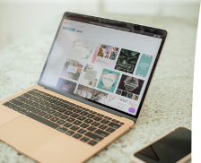
Tip 6: Use design tools like Canva to spruce up publicity materials
https://www.canva.com/

Slide 9
Tip 7: Build user-friendly website
►Optimize for mobile devices
►Incorporate engaging photos and videos
►Include place to capture visitor emails
►Update regularly

Slide 10
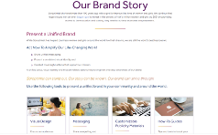
SIA Tools to Boost Club Digital Marketing Efforts
●Branding Guide
●Style Guide
●Social Media Guide
●Photo & Video Guide
●Website Guide

Slide 11
Please feel free to reach out to me with any questions regarding branding and/or if you need help with your social media and website
Babette Maiss, Public Awareness Chair
publicawareness@soroptimistsnr.org
530-321-5668

